Slide 1
Data-Science Overview
ADARSH PS
FUTURA LABS TECHNOLOGIES

Slide 2
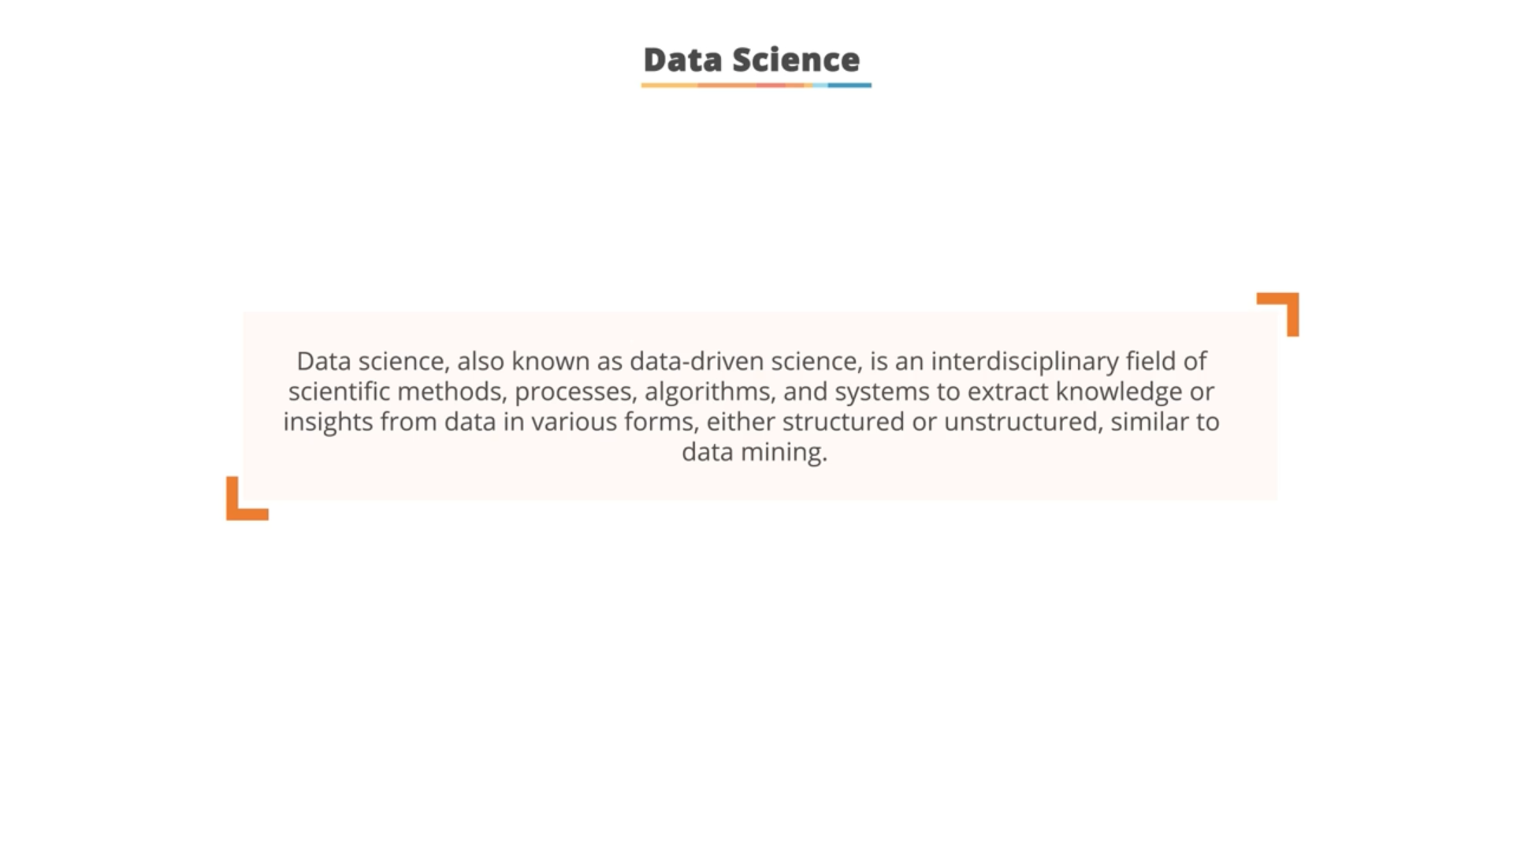

Slide 3
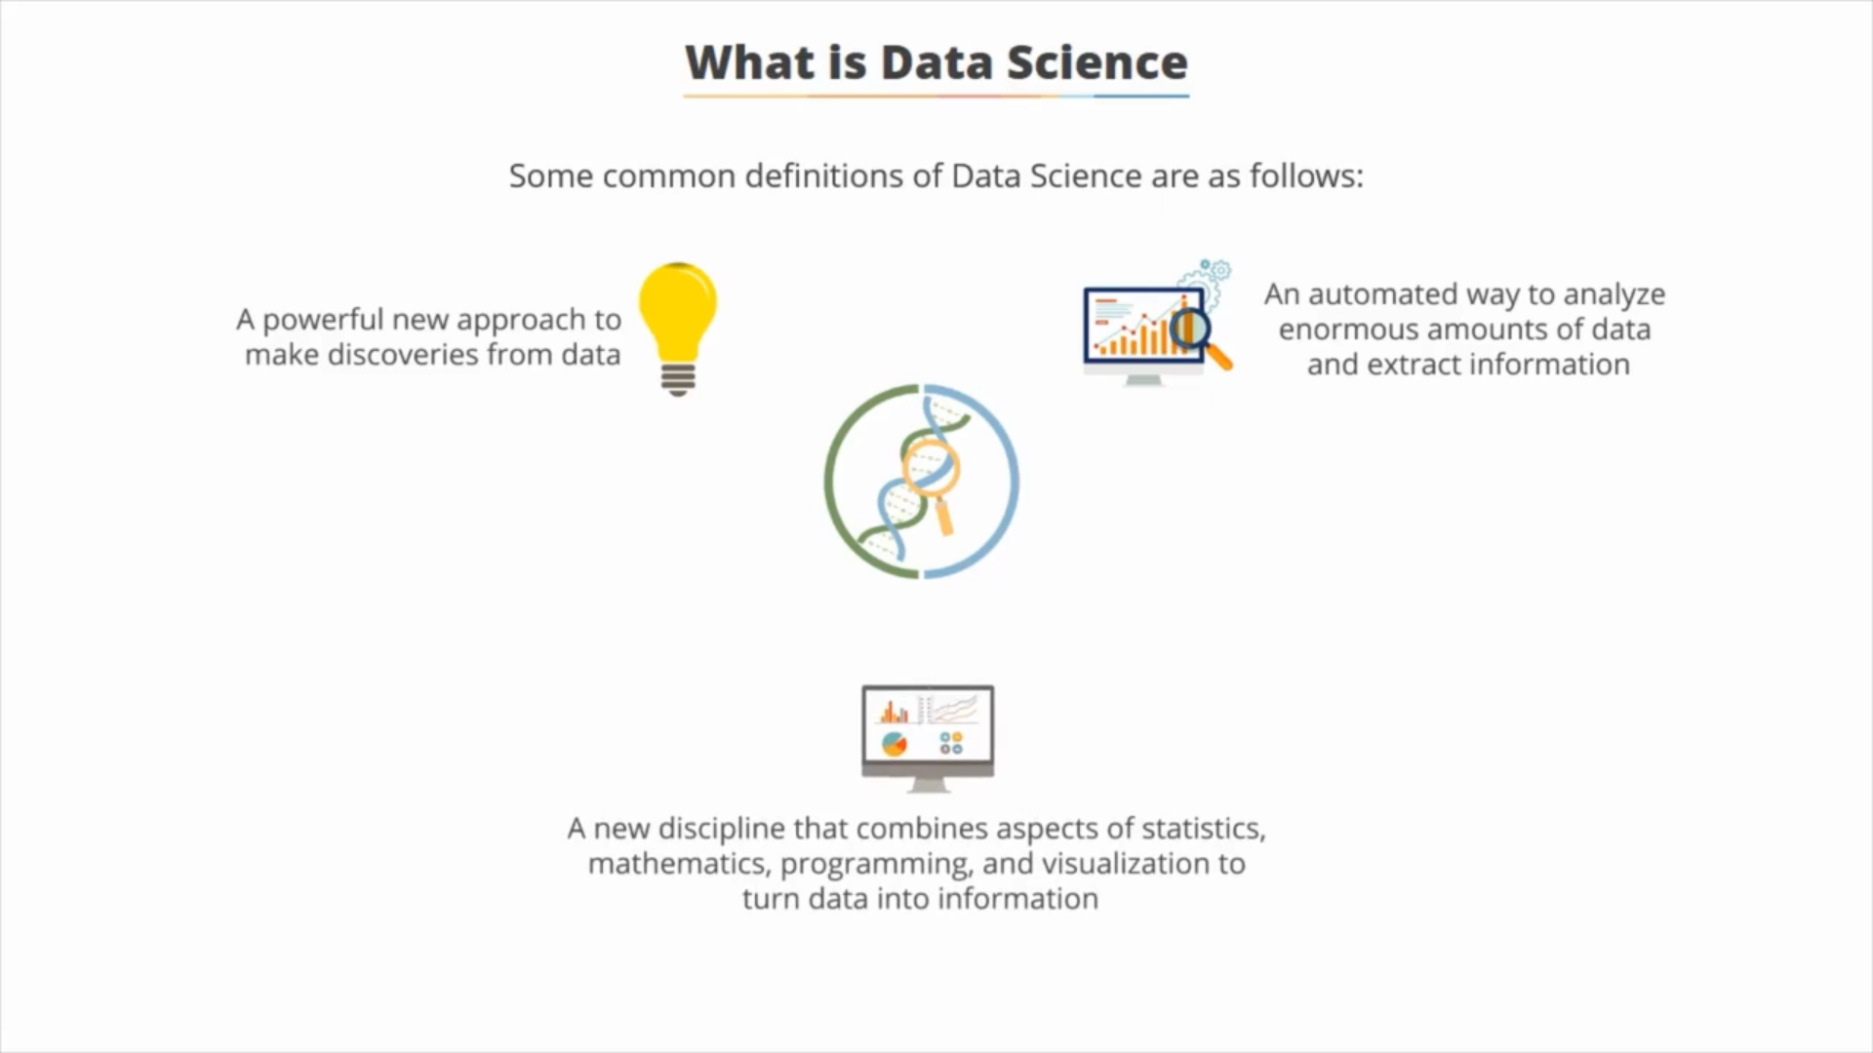

Slide 4
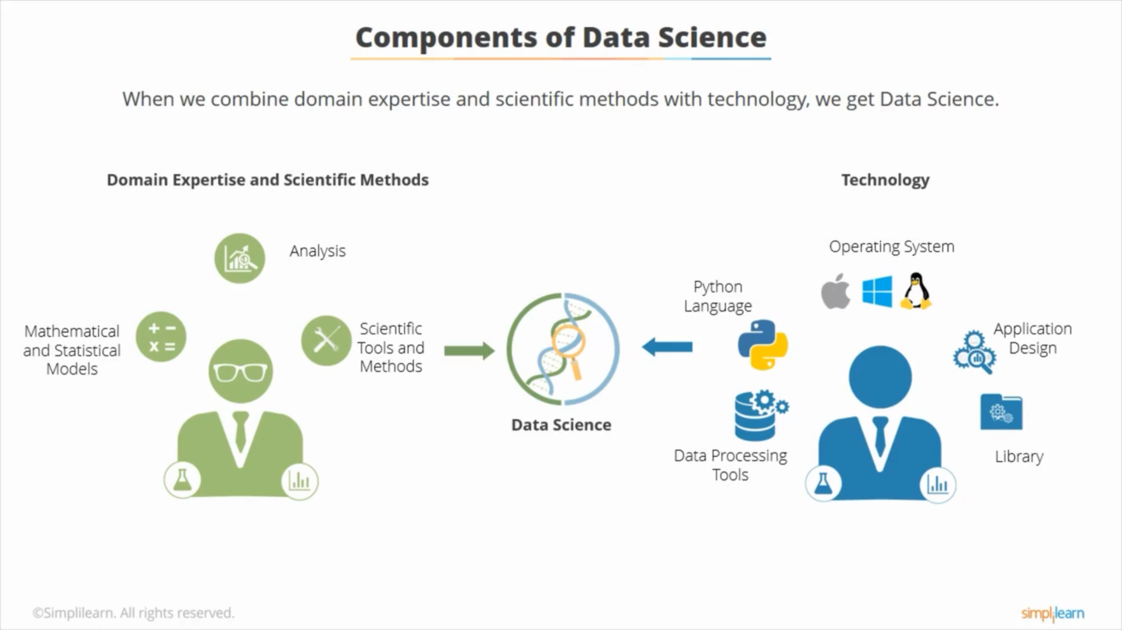

Slide 5
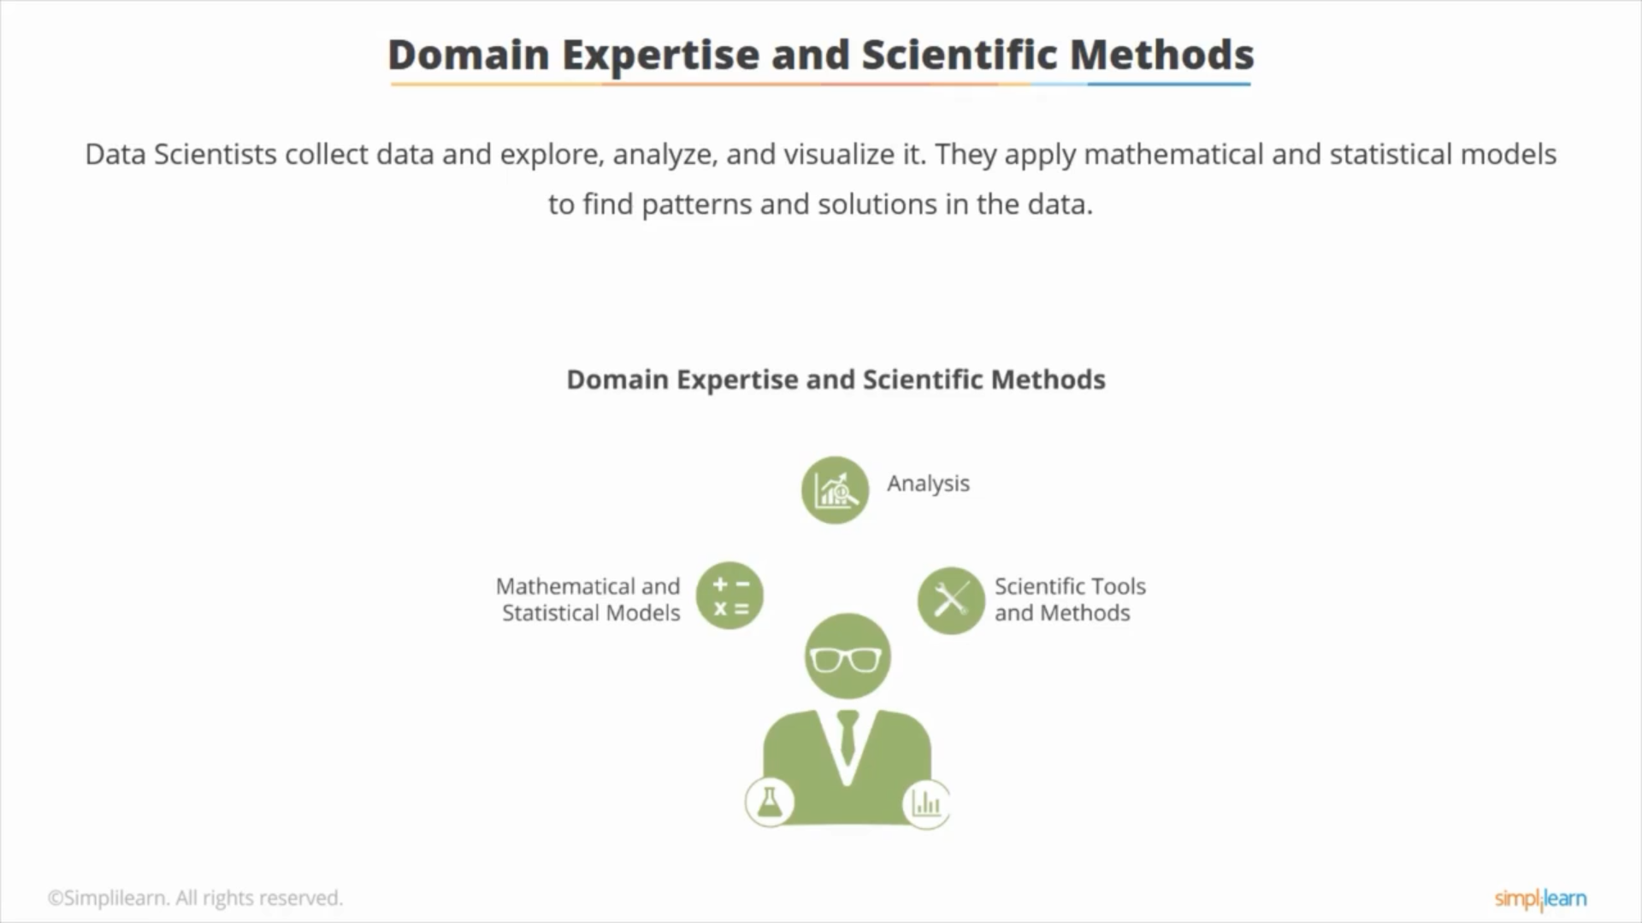

Slide 6
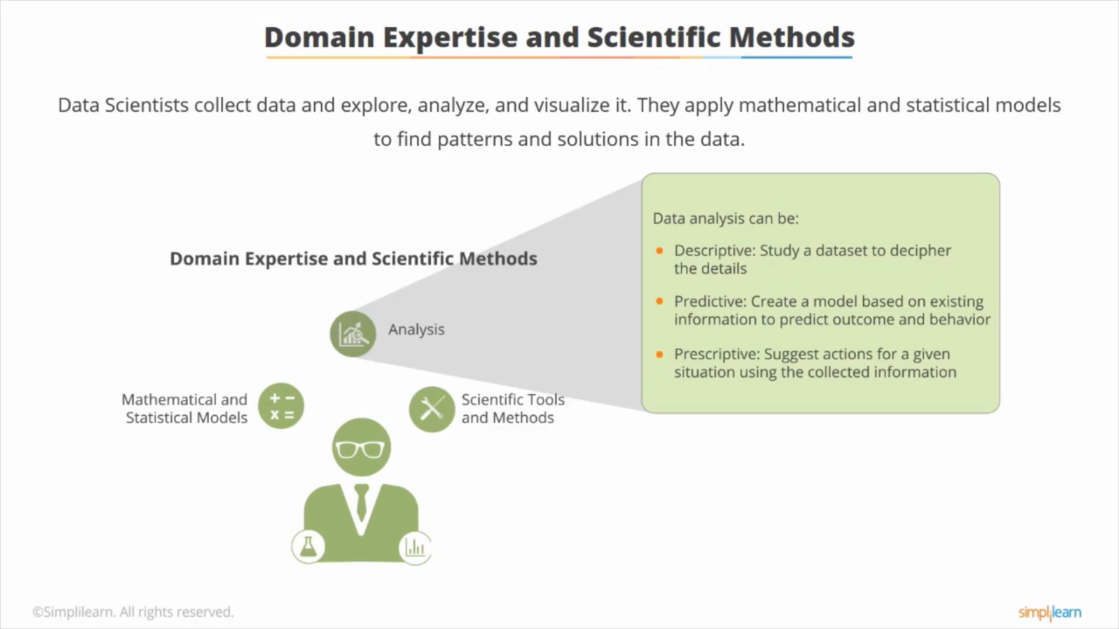

Slide 7
Descriptive analytics
What is happening in business?(past)
Ex: analyzing historic sales from consolidated data using data dashboards

Slide 8
Diagnostic analytics
Why it happened?(present)
Ex: Diet coke failure

Slide 9
Predictive analytics
Make business predictions using historic data, unforeseen events
Ex: Predicting future sales

Slide 10
Prescriptive analytics
Decision making

Slide 11
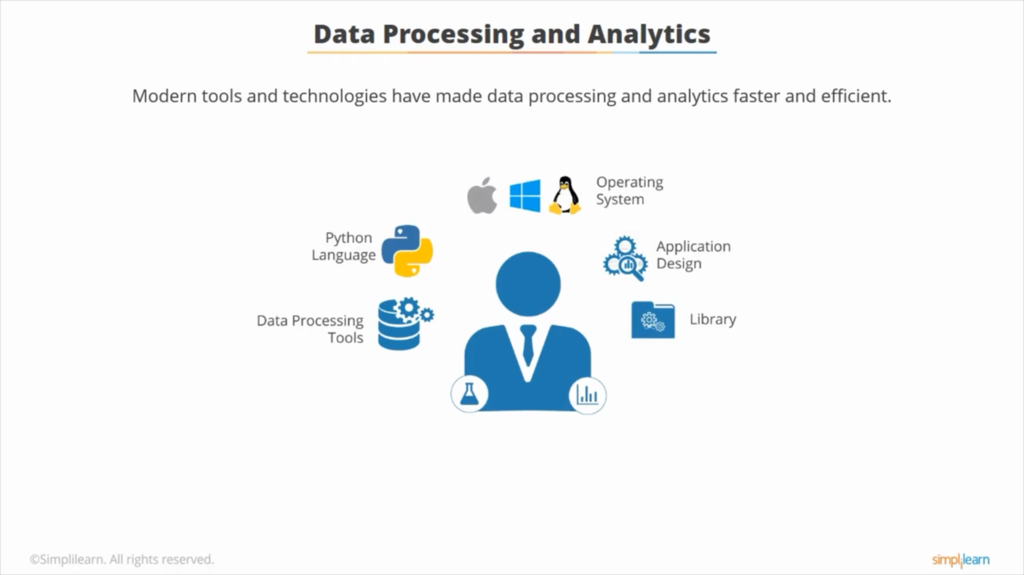

Slide 12
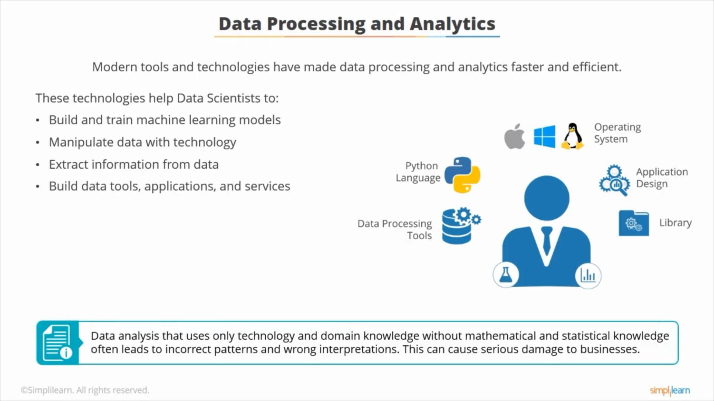

Slide 13
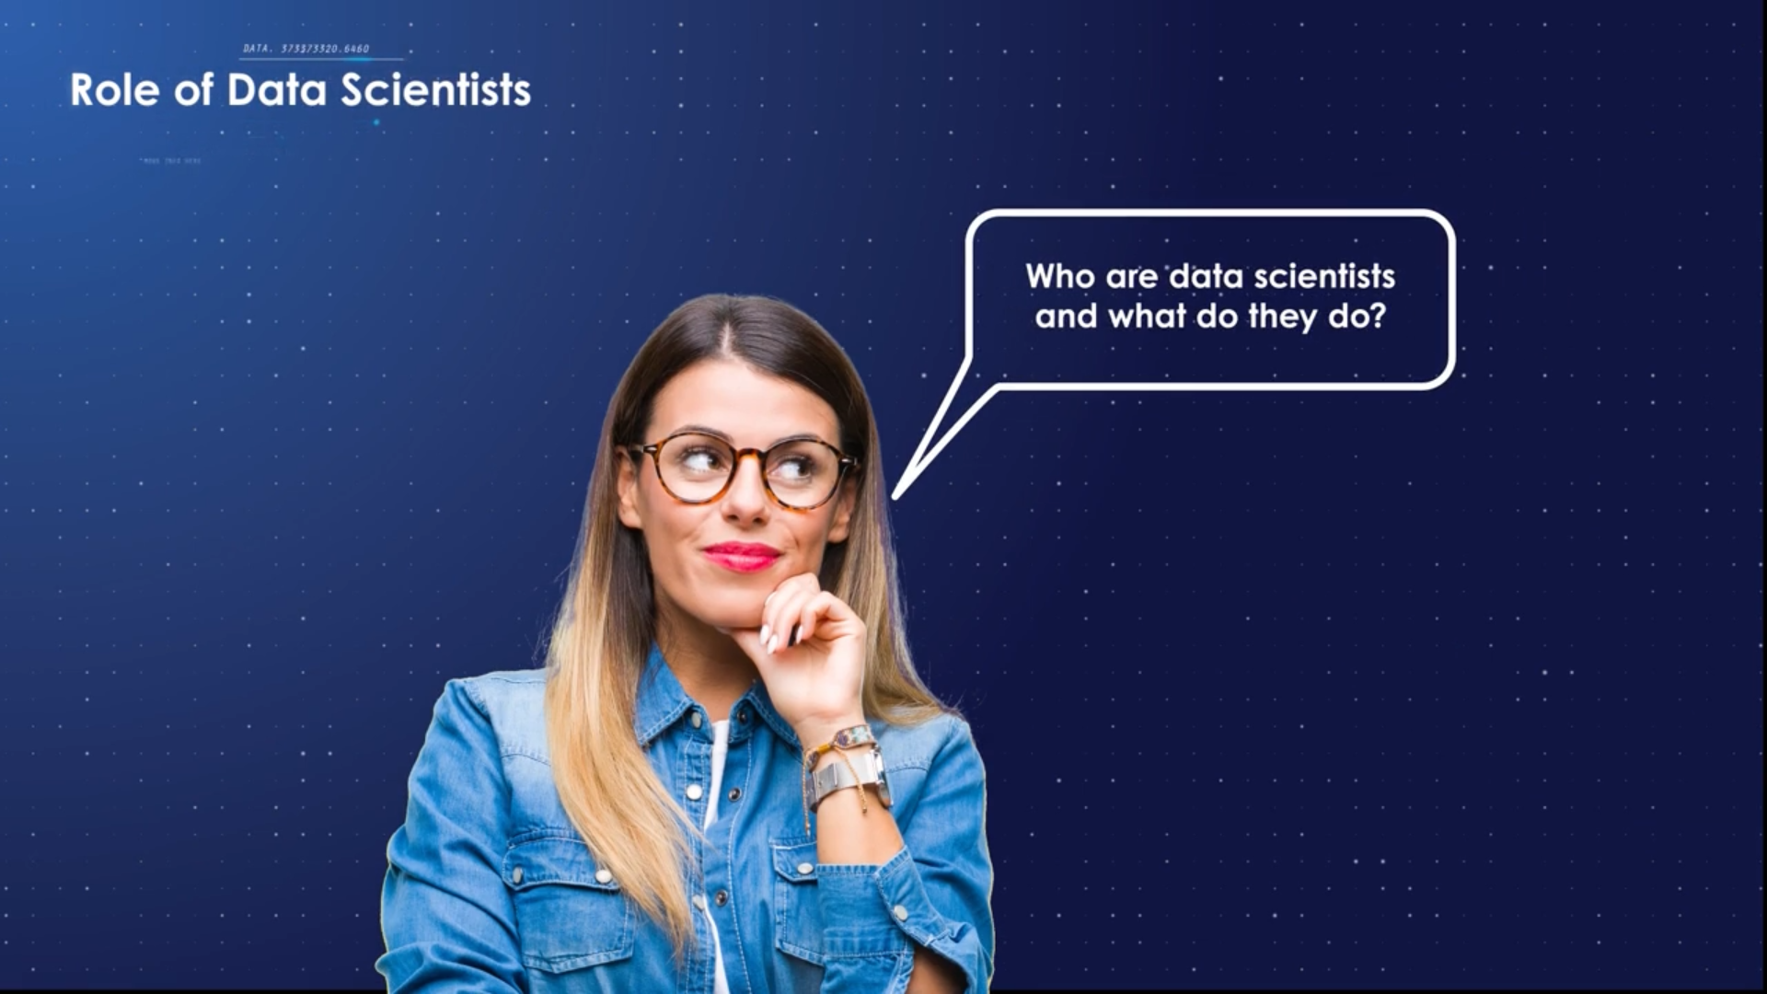

Slide 14
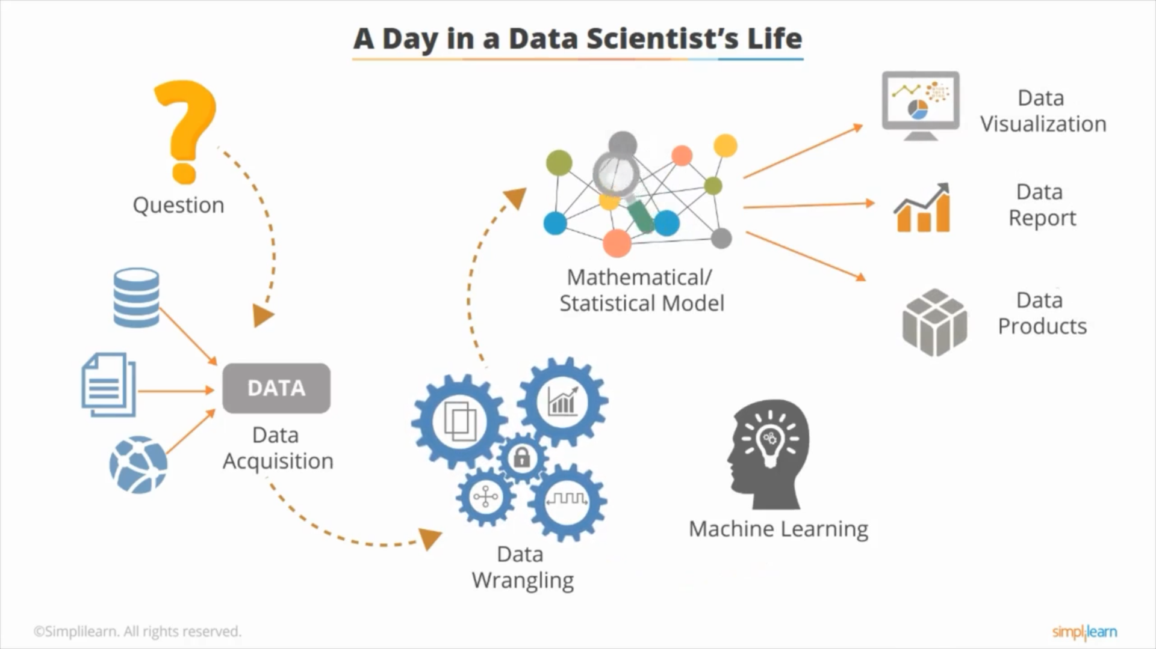

Slide 15
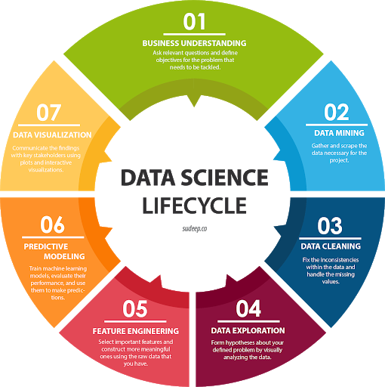
Data-Science Life Cycle

Slide 16
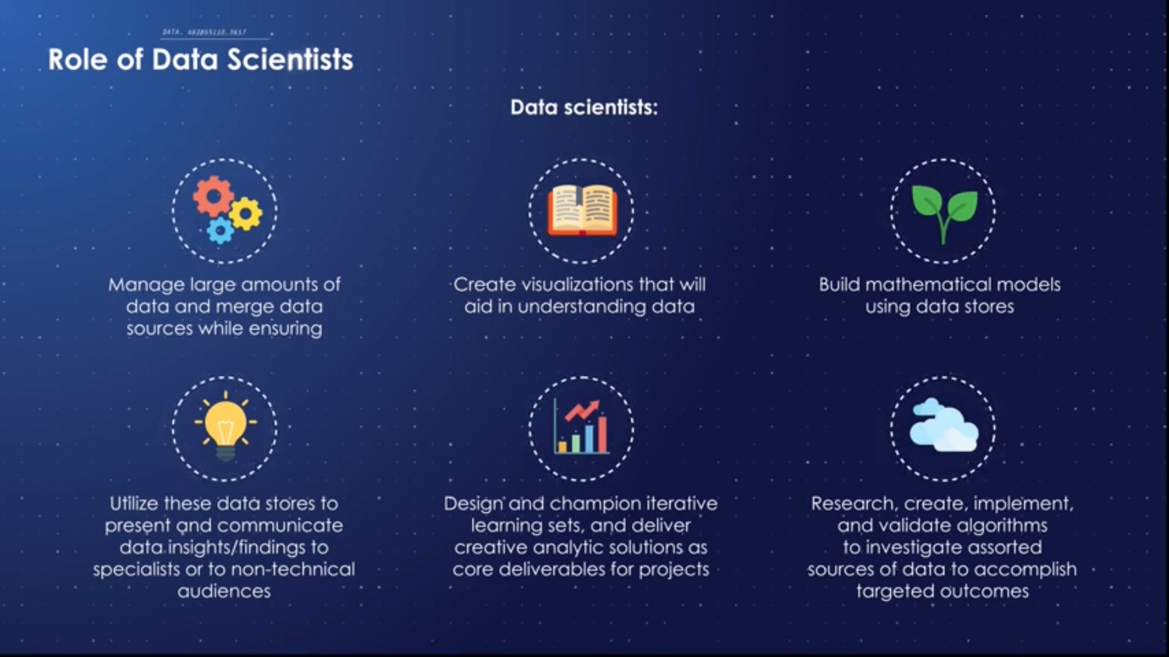

Slide 17
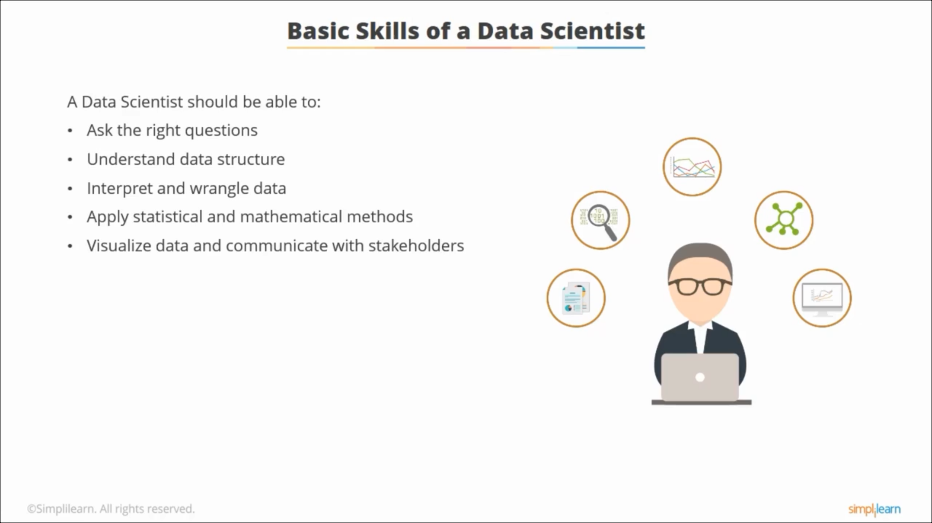

Slide 18
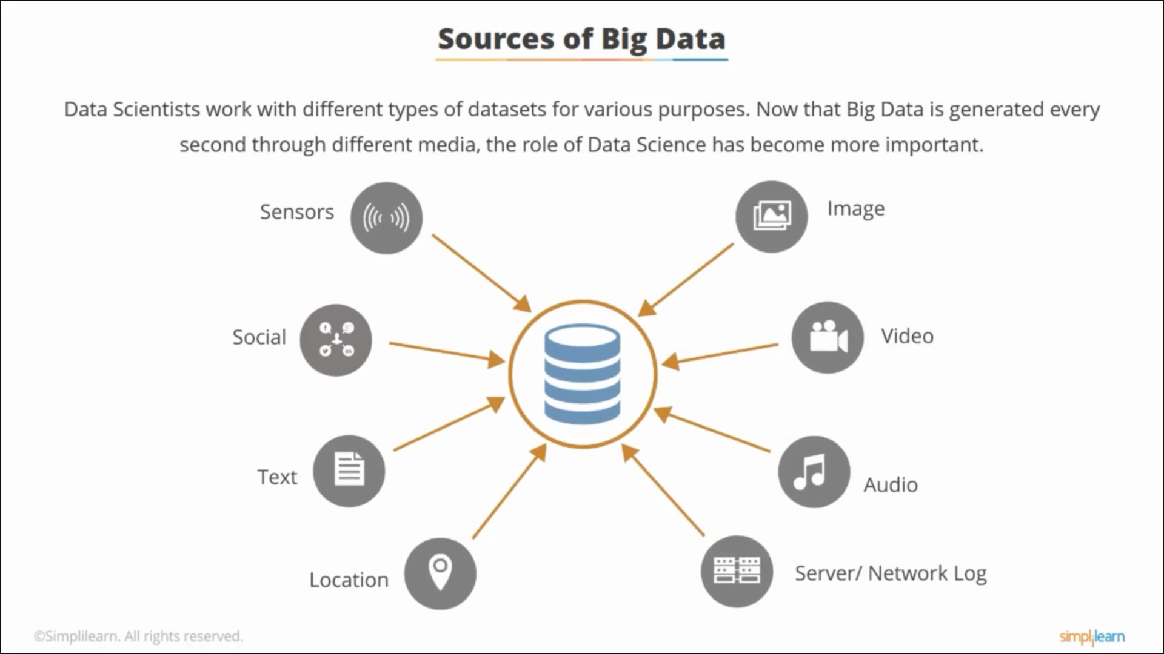

Slide 19
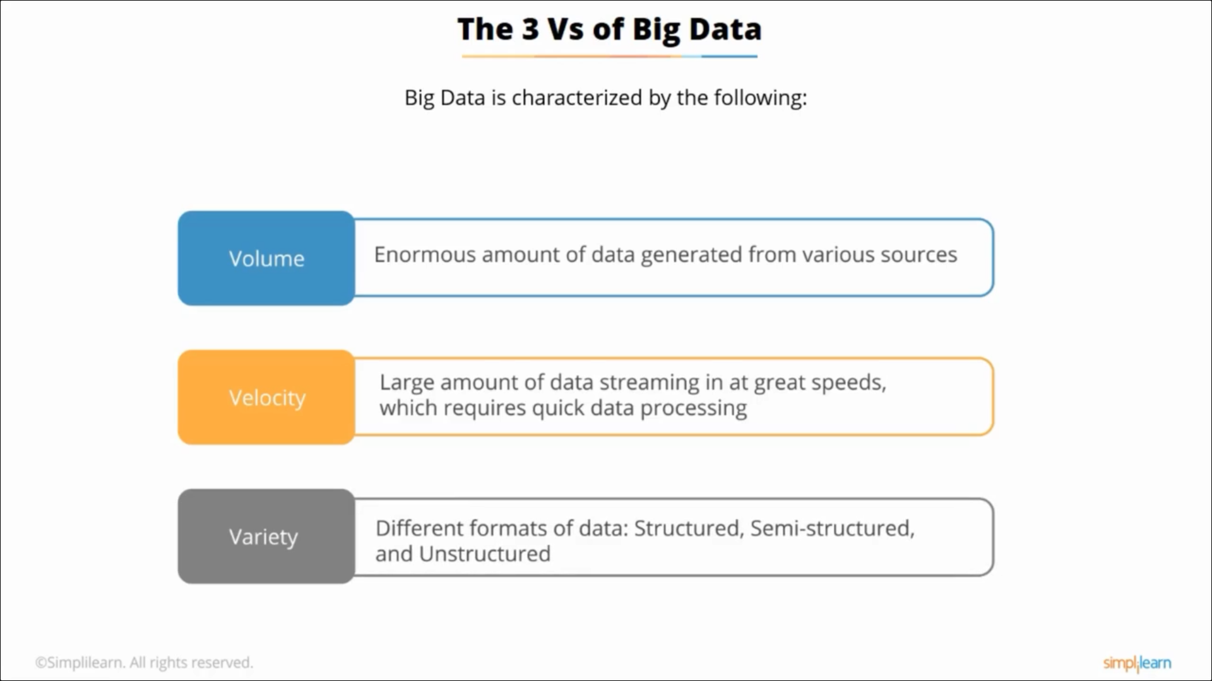

Slide 20
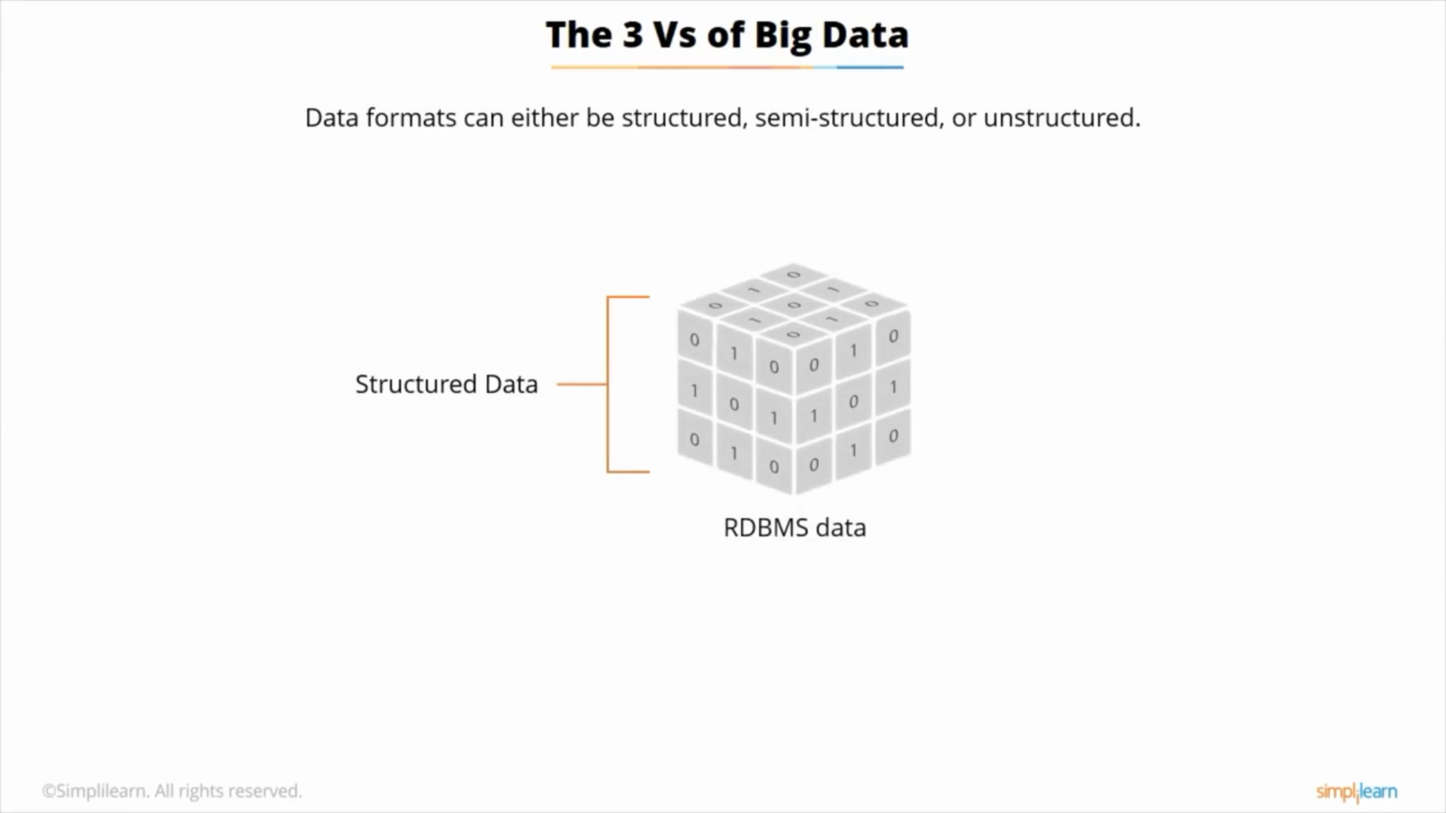

Slide 21
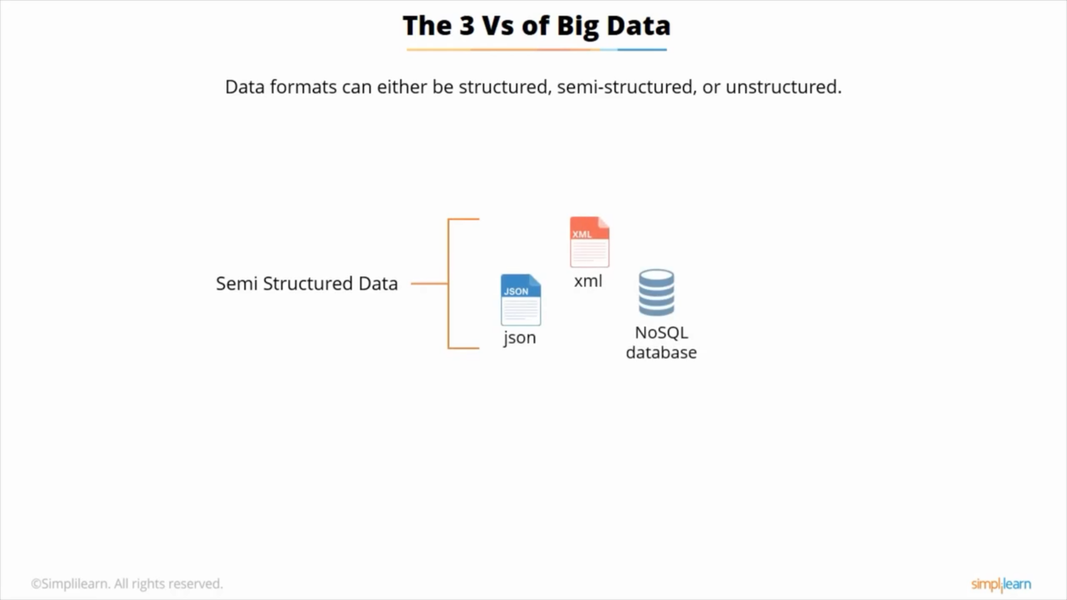

Slide 22
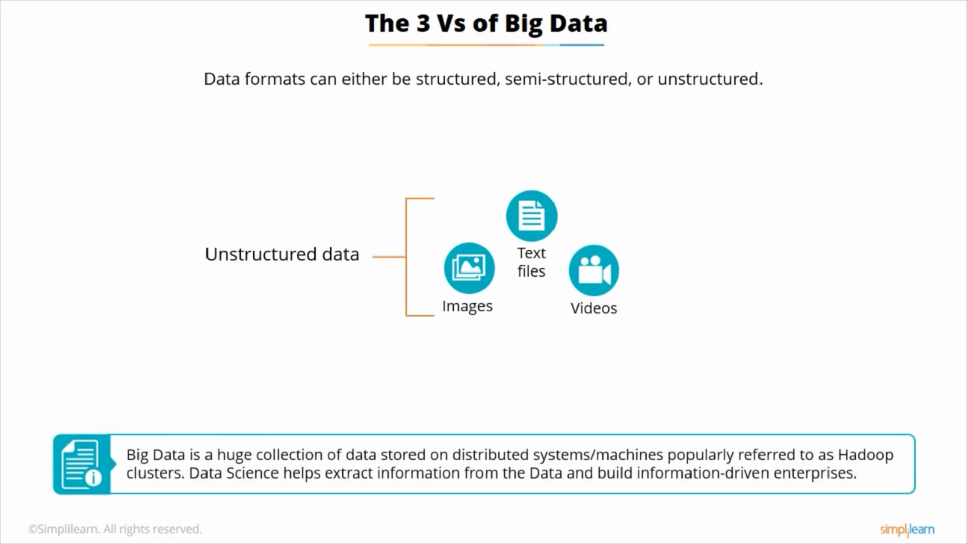

Slide 23
Difference between data scientists, engineers and analyst

Slide 24
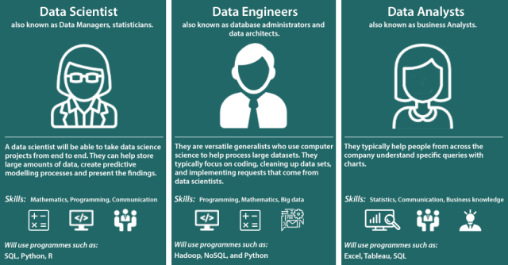

Slide 25
REAL-LIFE EXAMPLES OF DATA SCIENCE

Slide 26
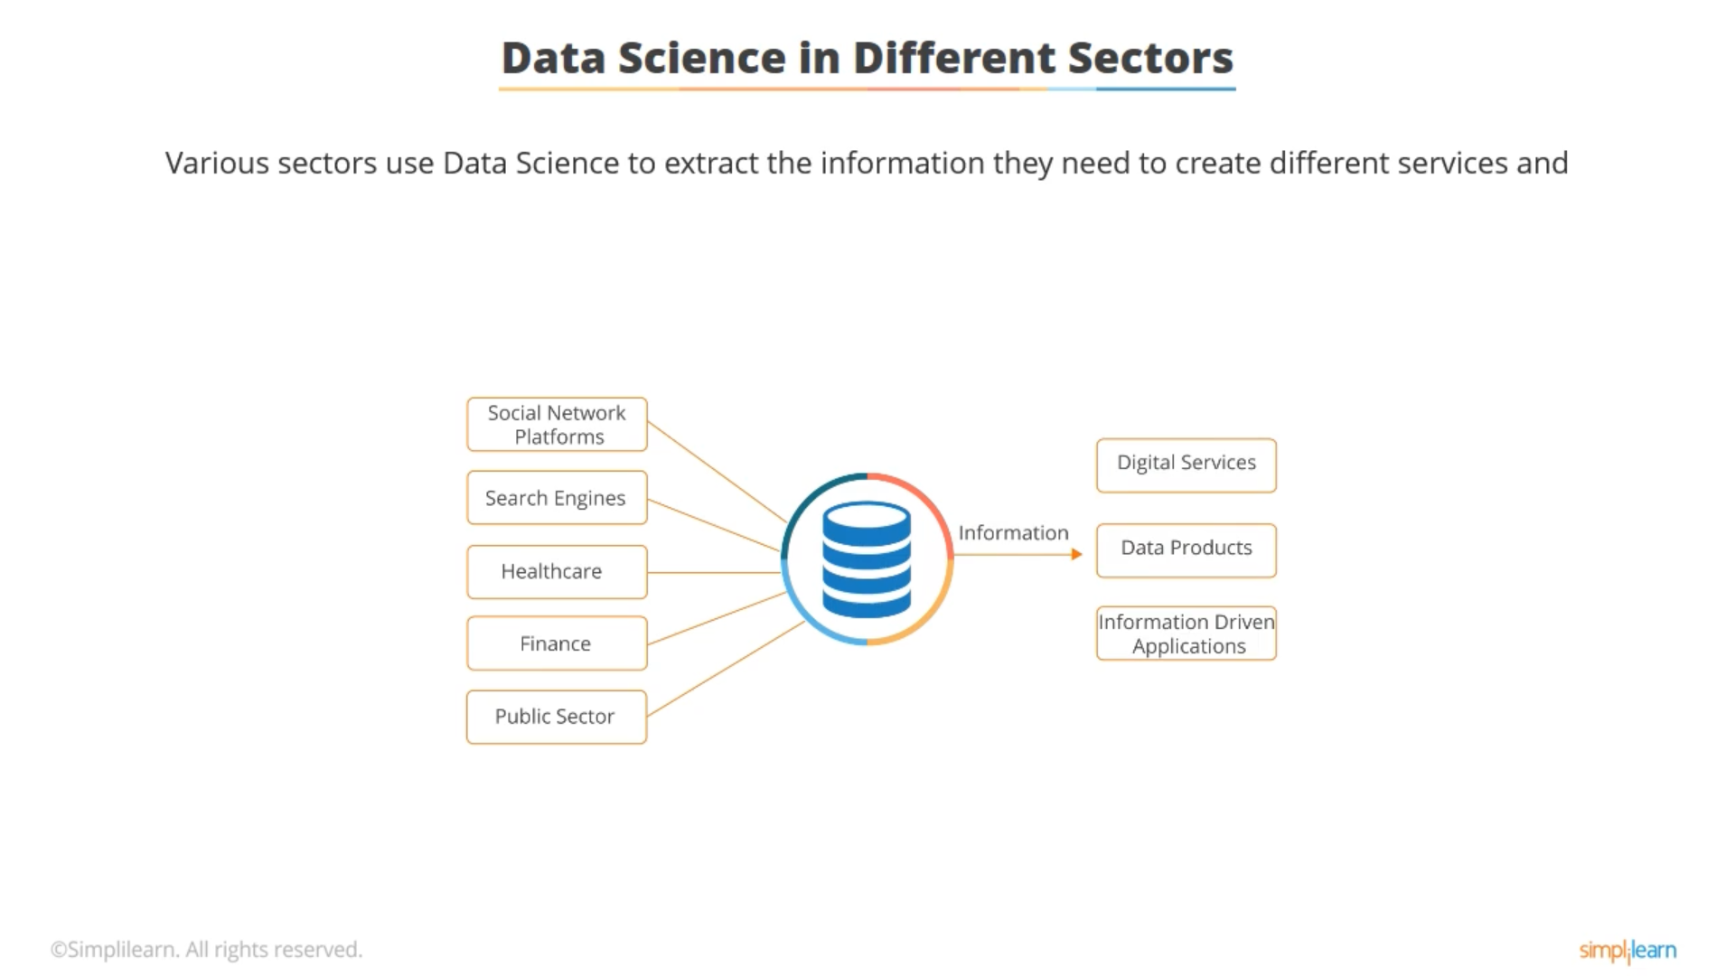

Slide 27
Internet search engines
All search engines, including DuckDuckGo, AOL, Bing, Yahoo, and of course, Google, use data science tools to provide personalized search results in seconds
Given the fact that Google has been known to handle over 20 petabytes of data each day if data science didn’t exist, the internet search giant would not have been what it is today

Slide 28
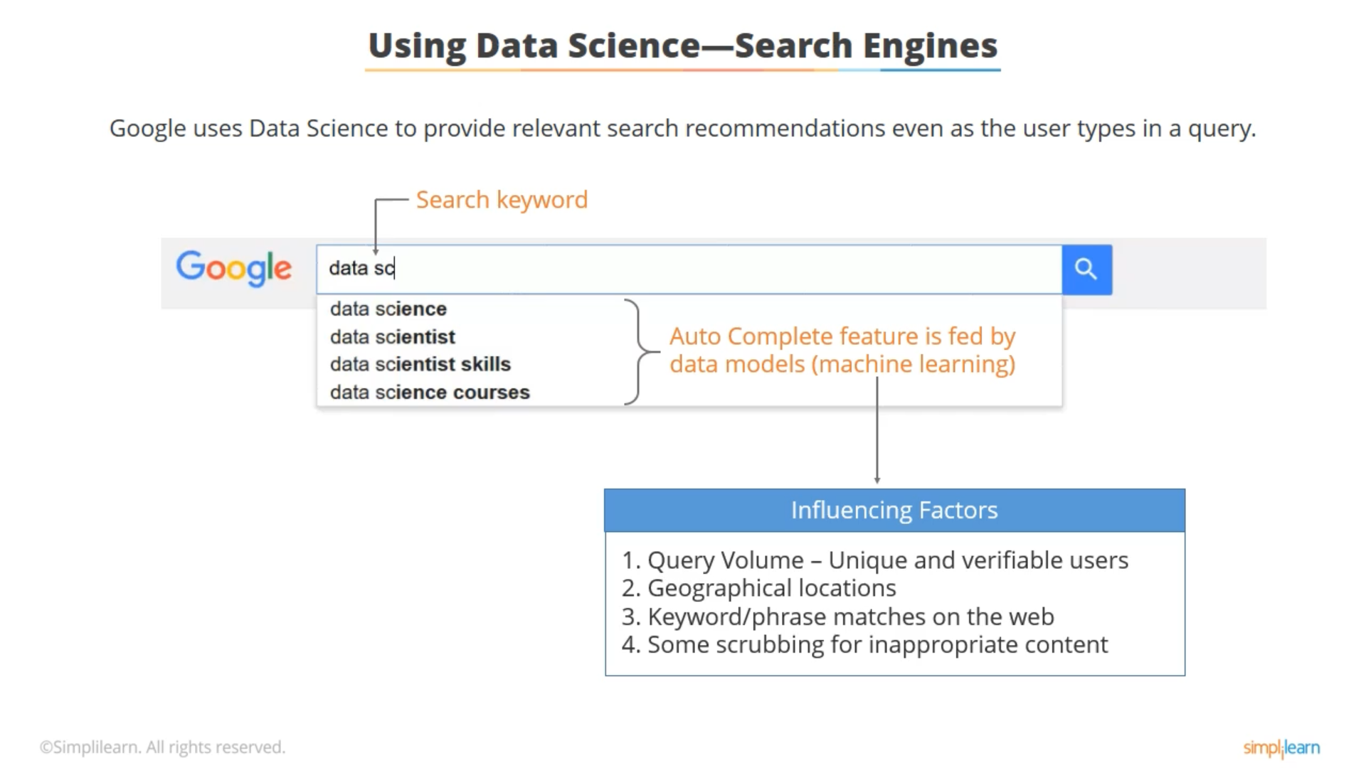

Slide 29
Recommendations
We are all familiar with Facebook’s friend suggestions, similar-product recommendations on Amazon, and individualized Netflix predictions based on past searches
These companies, out of billions of alternatives, suggest or recommend only the products and services relevant to a particular user, enhancing the user experience. Data science makes this possible

Slide 30
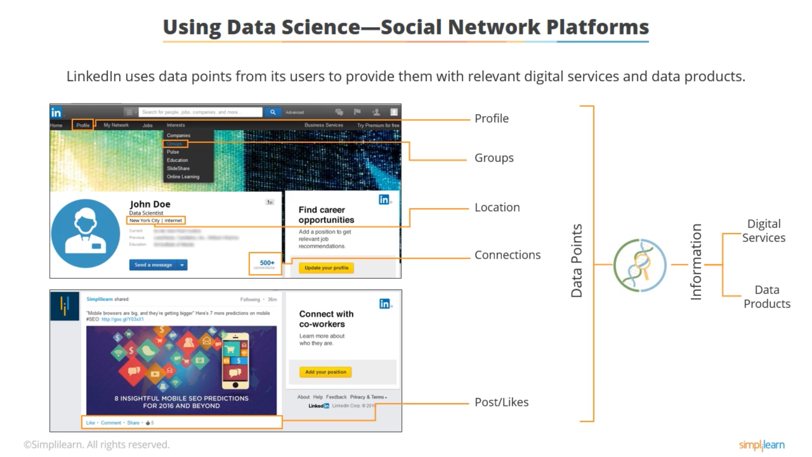

Slide 31
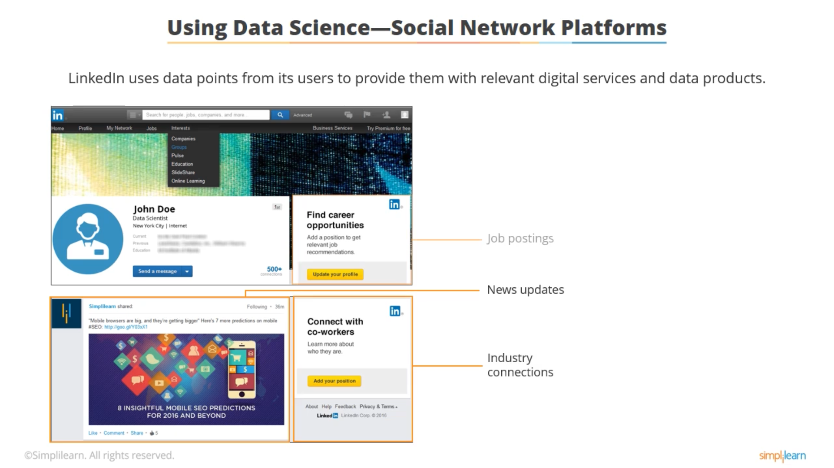

Slide 32
Image recognition
When Facebook users upload their images with friends, Facebook instantly starts providing them with suggestions to tag their friends. By applying face recognition algorithms, data science powers this automated tagging feature on Facebook.
Be it Facebook, WhatsApp, Google, or any other application, data science is at the root of all image recognition techniques

Slide 33
Speech recognition
Voice-based services offered by Google Assistant, Apple Inc.’s Siri, Microsoft Cortana, and Amazon’s Alexa are the best examples of speech recognition software
These products, using data science, make life easier by enabling users to perform tasks by merely speaking out. The user’s voice gets converted into text automatically

Slide 34
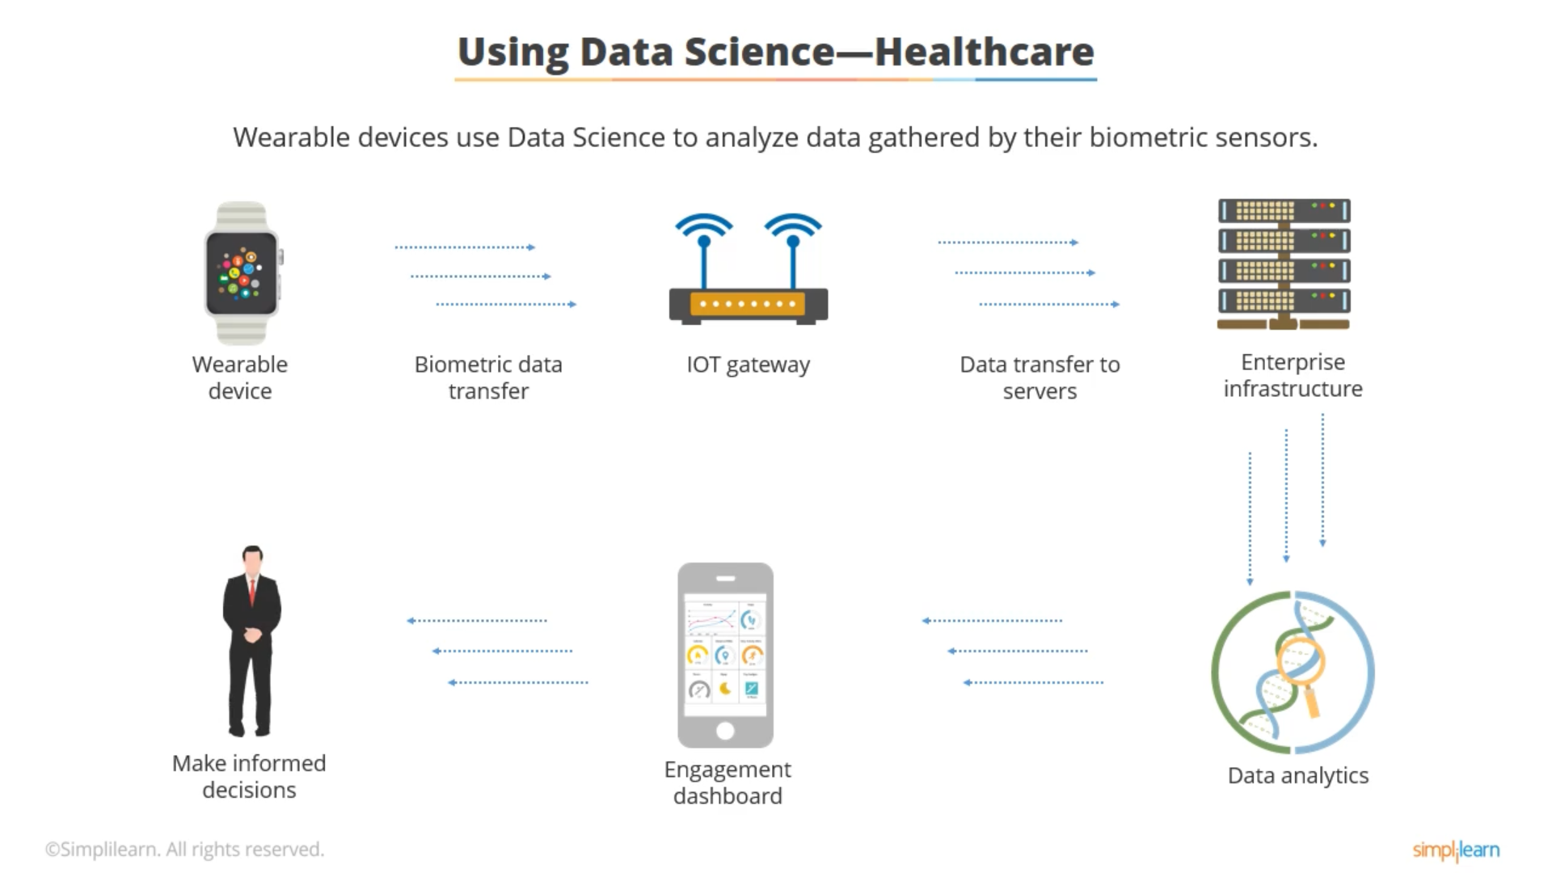

Slide 35
The industry applications of data-science

Slide 36
Healthcare
By integrating machine learning algorithms, statistics, analytics, and pattern recognition, data science improves the efficiency of the healthcare industry
Data scientists quickly detect and track health issues, reducing risks, and enriching the quality of human life

Slide 37
Finance
The role of data science in the financial sector is diverse, and it includes customer experience analysis, detection of fraudulent behavior, identifying credit or debit card misuse, personalized recommendations, and risk assessment

Slide 38
Manufacturing
As traditional industrial and manufacturing practices are getting automated at a rapid pace, the need to adopt data science is also increasing, enabling smart factory solutions.
Using AI-powered predictive analytics, data scientists are helping the manufacturing industry with preventive maintenance, such as troubleshooting potential equipment issues, which reduces delays and speeds up production.

Slide 39
Energy sector
By using predictive models, data scientists enable energy companies to cut costs, lower risks, reduce their downtime, and optimize investments while enhancing equipment maintenance capabilities.

Slide 40
pharmaceuticals
Leading pharmaceutical companies are using data science to develop more stable solutions for planning and conducting clinical trials.
Data science is helping pharmaceutical organizations predict and evaluate the success/failure ratio of their clinical trials, minimizing both risks and costs.
Data science is helping pharmaceutical organizations predict and evaluate the success/failure ratio of their clinical trials, minimizing both risks and costs.

Slide 41
Population and sample data

Slide 42
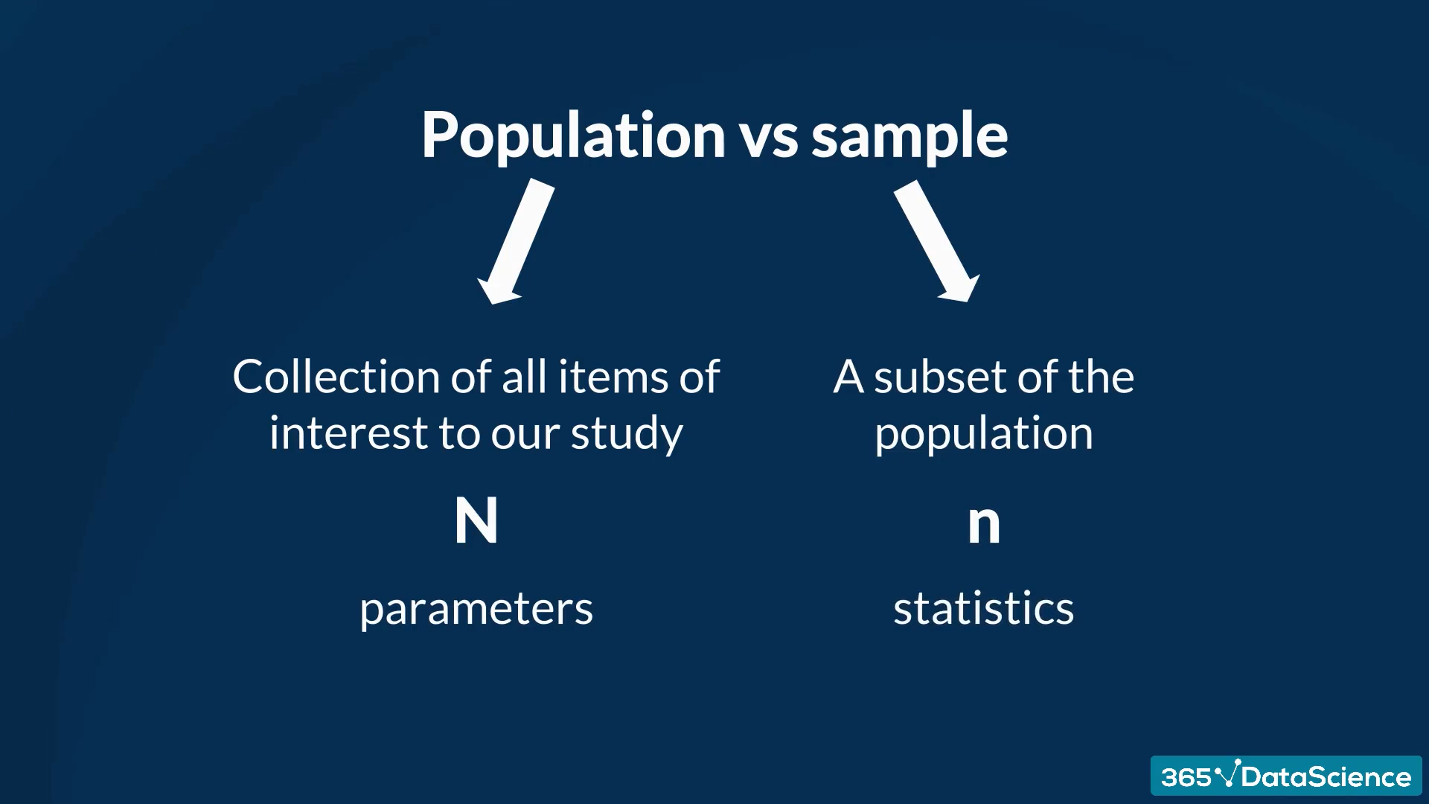

Slide 43
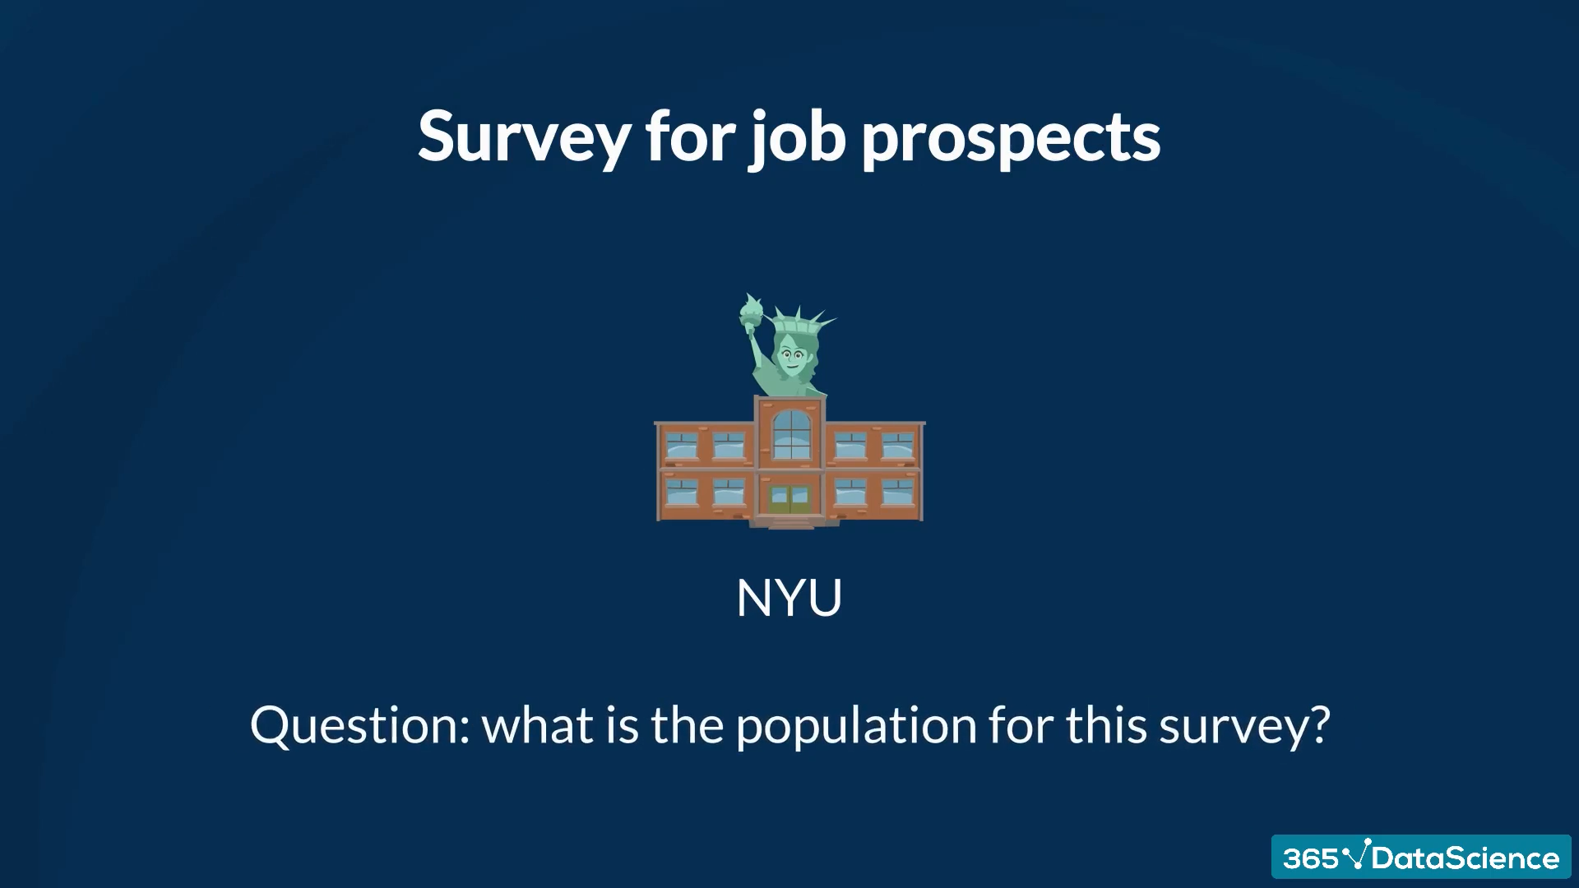

Slide 44
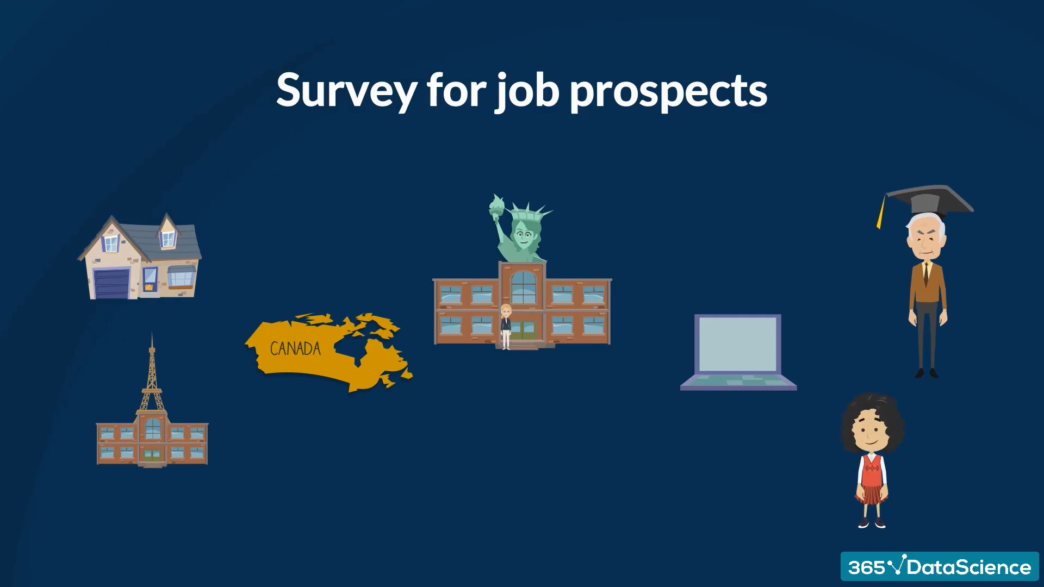

Slide 45
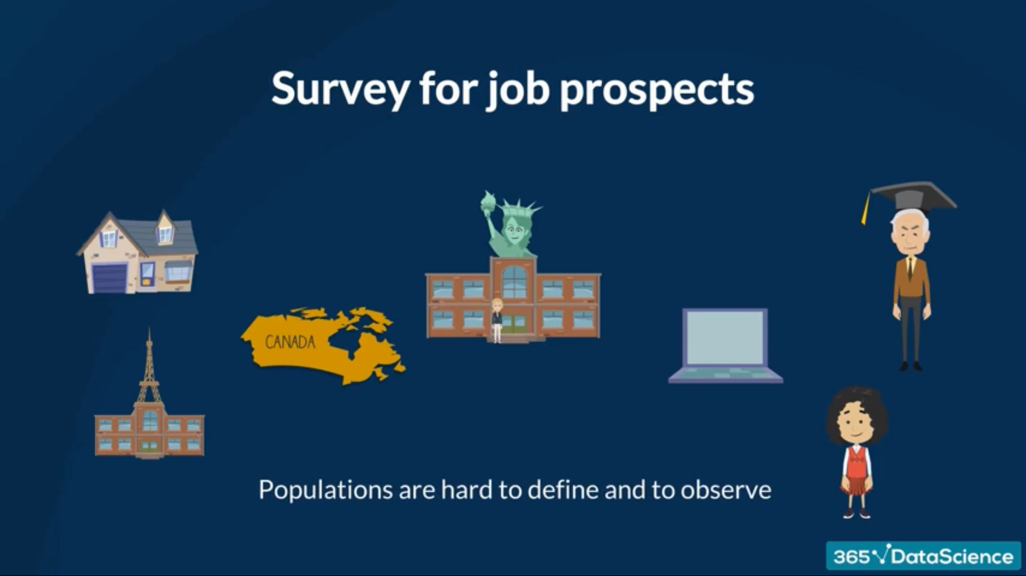

Slide 46
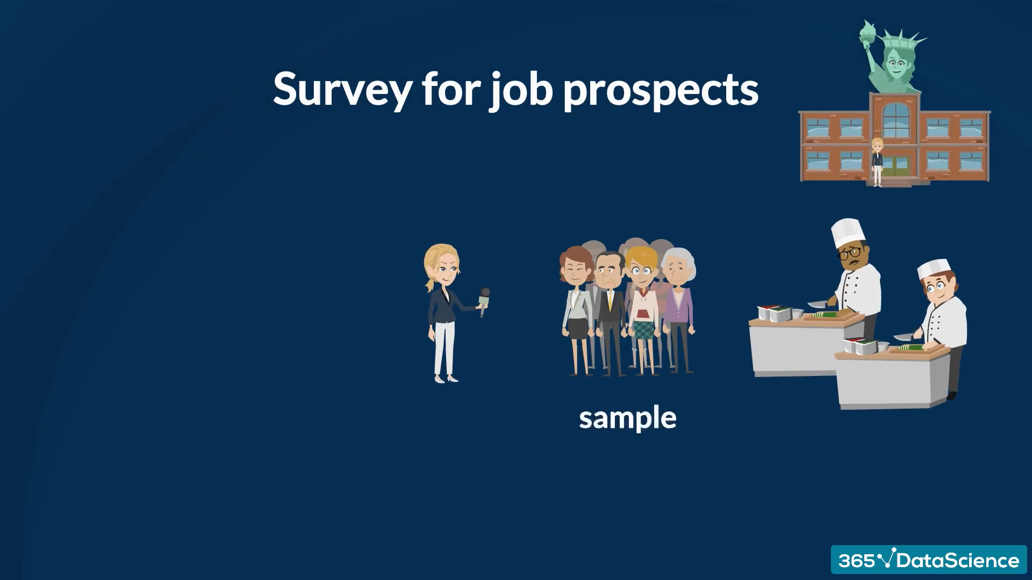

Slide 47
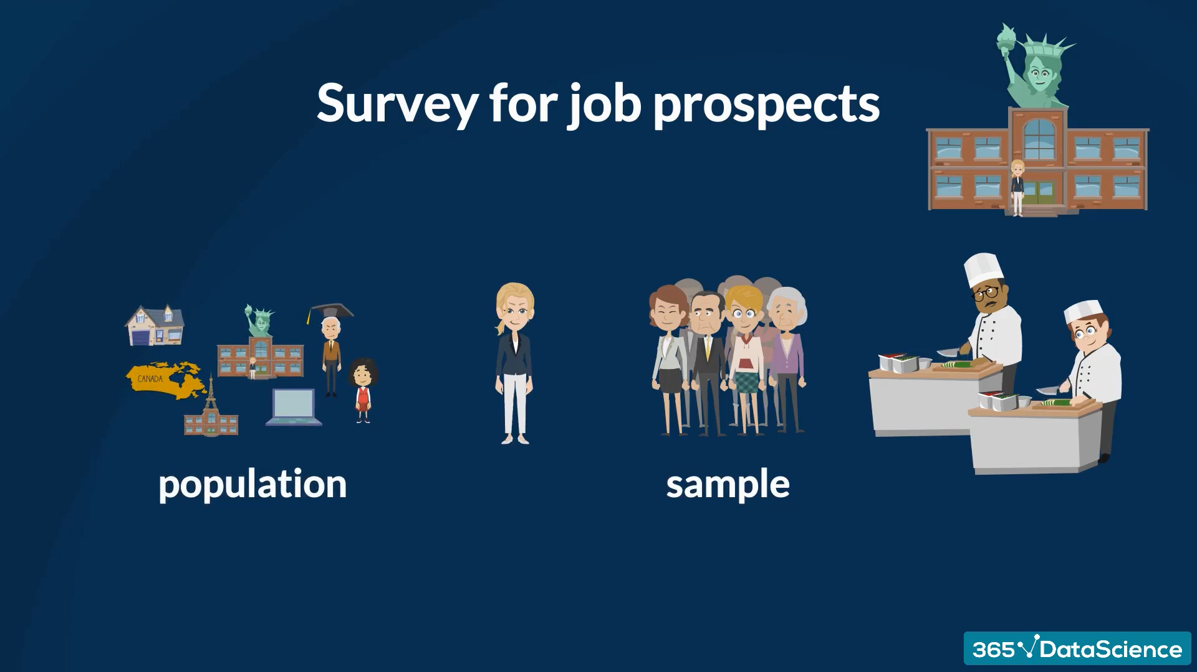

Slide 48
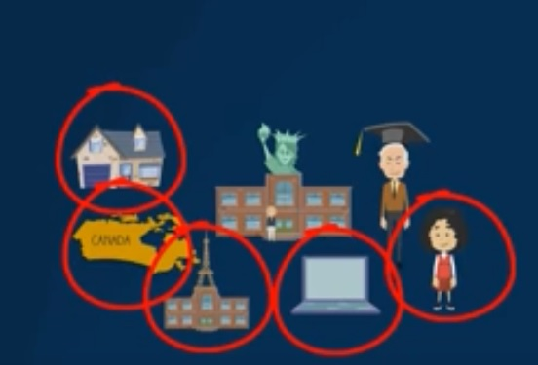
A good sample should be randomly selected from all areas representing the population

Slide 49
Data-science terminologies

Slide 50
Data engineer
Data engineers develop the infrastructure that facilitates the collection, cleaning, and processing of data, which data scientists use to generate insights.

Slide 51
Machine learning
Machine Learning (ML), an AI (Artificial Intelligence) subset, refers to techniques that data scientists apply to make computers (machines) learn from inputted data. ML techniques generate results without explicit programming rules.

Slide 52
classification
Classification is a process to classify data into different classes. The purpose of Classification is to determine the class/category under which new datasets will fall.

Slide 53
Cross-validation
Cross-Validation involves methods to validate the accuracy or stability of machine-learning models

Slide 54
clustering
Clustering refers to finding and segregating data points into groups that have similar traits.

Slide 55
Deep learning
An advanced machine learning form that mimics the human brain, in-depth learning methodologies, based on ANN (Artificial Neural Network), can detect objects, translate languages, recognize speech, and make decisions from insights drawn from both unlabeled and unstructured data.

Slide 56
Hypothesis testing
Introduced by Karl Pearson, Ronald Fisher, and Jerzy Neyman, Hypothesis Testing refers to statistical methods that are used to make statistical decisions. It is often applied in clinical research

Slide 57
EDA (Exploratory Data Analysis)
EDA techniques help summarize the main characteristics of datasets using visual methods. With Exploratory Data Analysis, data scientists can “see” what data tells them beyond hypothesis testing or formal modeling

Slide 58
Data Visualization
Through visual elements, such as maps, charts, and graphs, data visualization offers a graphical portrayal of data that helps data scientists visualize and understand data trends, patterns, and outliers.

Slide 59
Prerequisite skills for data-science
Statistical knowledge
Programming knowledge (Python & R mostly used)
Analytical skills
infrastructure knowledge
Communication skills

Slide 60


